Slide 1

Utilizing the Clay Foundation Model and Sentinel-2 Imagery for Urban Growth Monitoring in Johnston County, NC
Benton Tripp
Notes:
Hello, my name is Benton Tripp. Today I will present a proof-of-concept study that integrates Sentinel-2 multispectral satellite imagery with the Clay Foundation Model, an open-source earth foundation model for Earth observation, to monitor urban growth in Johnston County, North Carolina. The central motivation arises from the need for more frequent and timely estimates of urban growth than what standard land cover products, such as the National Land Cover Database (NLCD), currently provide. By leveraging foundation models and deep learning, the goal of this study is to address these temporal gaps, thereby informing more sustainable urban planning and environmental management.
Beyond improving the update frequency and accuracy of urban imperviousness mapping, this research also illustrates how emerging “foundation models” for Earth observation can fill some of the voids in existing data and workflows. By harnessing these models’ advanced representation learning capabilities, it becomes possible to quickly adapt to a variety of remote sensing tasks, scaling analyses with minimal additional training data. This approach demonstrates the broader potential of such models to enhance current geospatial monitoring efforts.

Slide 2
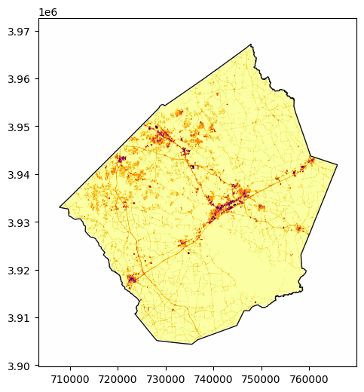
Introduction
Rapid urbanization alters land use and ecology
Impervious surfaces track urban expansion
Five-year NLCD data updates often miss rapid changes
Timely imperviousness estimates support better planning
NLCD 2016 Urban Imperviousness - Johnston County, NC
Notes:
Urbanization reshapes landscapes, alters ecosystems, influences resource distribution, changes hydrological processes, and even can affect local climates. Impervious surfaces—roads, buildings, parking lots—function as key indicators of urban expansion. Although the National Land Cover Database (NLCD) provides authoritative baseline data on impervious surfaces, a five-year update cycle leaves gaps in capturing rapid transformations. The NLCD’s imperviousness estimates, developed from high-resolution training data and applied to Landsat imagery using machine learning, integrate roads, buildings, and other datasets to yield nuanced insights. Yet static temporal resolutions fail to represent evolving urban landscapes adequately.
To address these deficiencies, this analysis integrates Sentinel-2 satellite imagery with the Clay Foundation Model, a recently developed Earth observation foundation model. The combined approach produces more frequent and detailed imperviousness estimates, aligning the NLCD’s rich impervious surface products with a higher-temporal-resolution method. This demonstration shows how emerging Earth observation foundation models can supplement existing datasets, enhancing the timeliness and responsiveness of urban growth assessments without relying on extensive new training data.

Slide 3
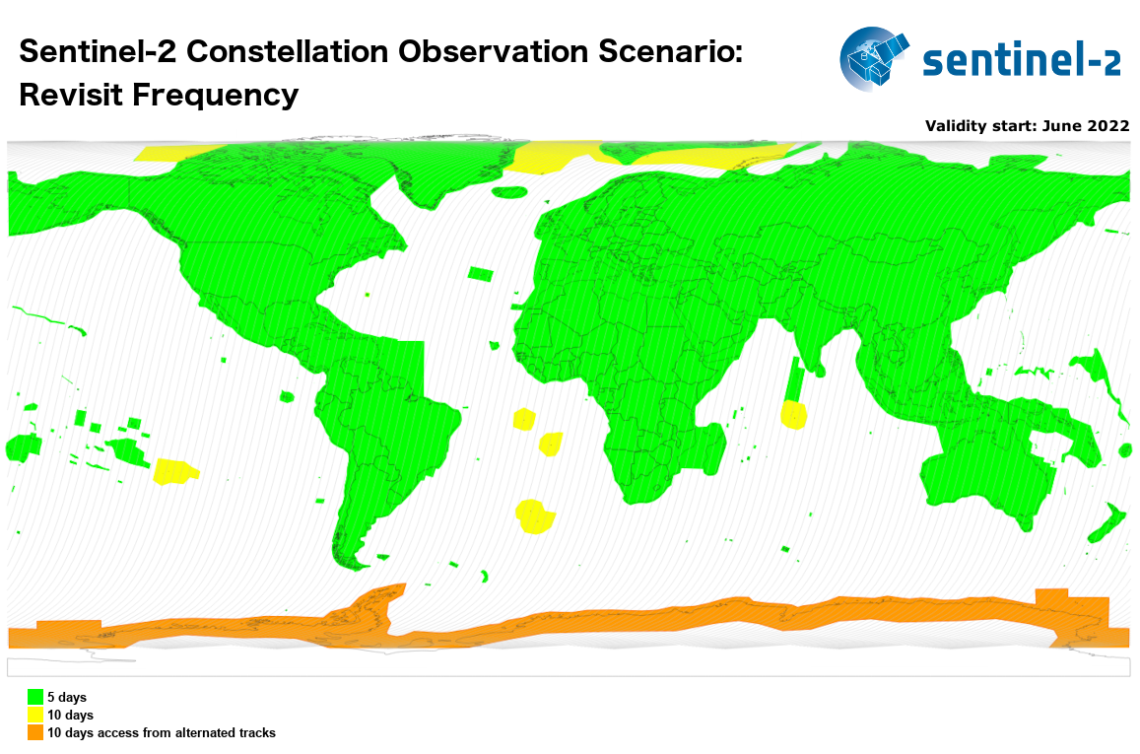
Motivation
Rapid development within Johnston County, NC could be benefited by more granular monitoring
Five-day revisit frequency from Sentinel-2 supports high-temporal-resolution analysis
Foundation models allow more data-efficient adaptation to evolving remote sensing tasks
Coverage and revisit time for Sentinel-2 MSI acquisitions
Notes:
The motivation for the specific data and methodologies chosen for this study include:
Johnston County’s status as a rapidly growing area within the Raleigh-Durham-Chapel Hill metropolitan region identifies this location as an ideal case study.
The Sentinel-2 five-day revisit cycle provides frequent, high-resolution imagery suitable for detecting changes at finer temporal scales.
The emergence of foundation models in Earth observation, analogous to large-language models in natural language processing, offers a scalable approach. Pre-trained on extensive datasets, models such as the Clay Foundation Model can be adapted efficiently to downstream tasks with minimal additional labeling, thereby reducing data acquisition burdens associated with traditional supervised machine learning methodologies.

Slide 4
Research Question and Objectives
Question: Does integrating a foundation model with Sentinel-2 data improve temporal resolution and accuracy of urban imperviousness mapping?
Objective: Establish a scalable, data-efficient framework that generates more frequent urban imperviousness estimates than the five-year NLCD cycle.
Notes:
The primary research question addresses whether integration of the Clay Foundation Model and Sentinel-2 data can enhance temporal resolution and accuracy in urban imperviousness mapping. The objective involves establishing a scalable, data-efficient framework to produce imperviousness estimates more frequently than the standard five-year update interval of datasets such as NLCD. By using pre-trained foundation model embeddings, optimized neural network architectures, and hyperparameter tuning, the proposed approach delivers timely insights into evolving urban conditions, providing a basis for adaptive planning and sustainable resource allocation.

Slide 5
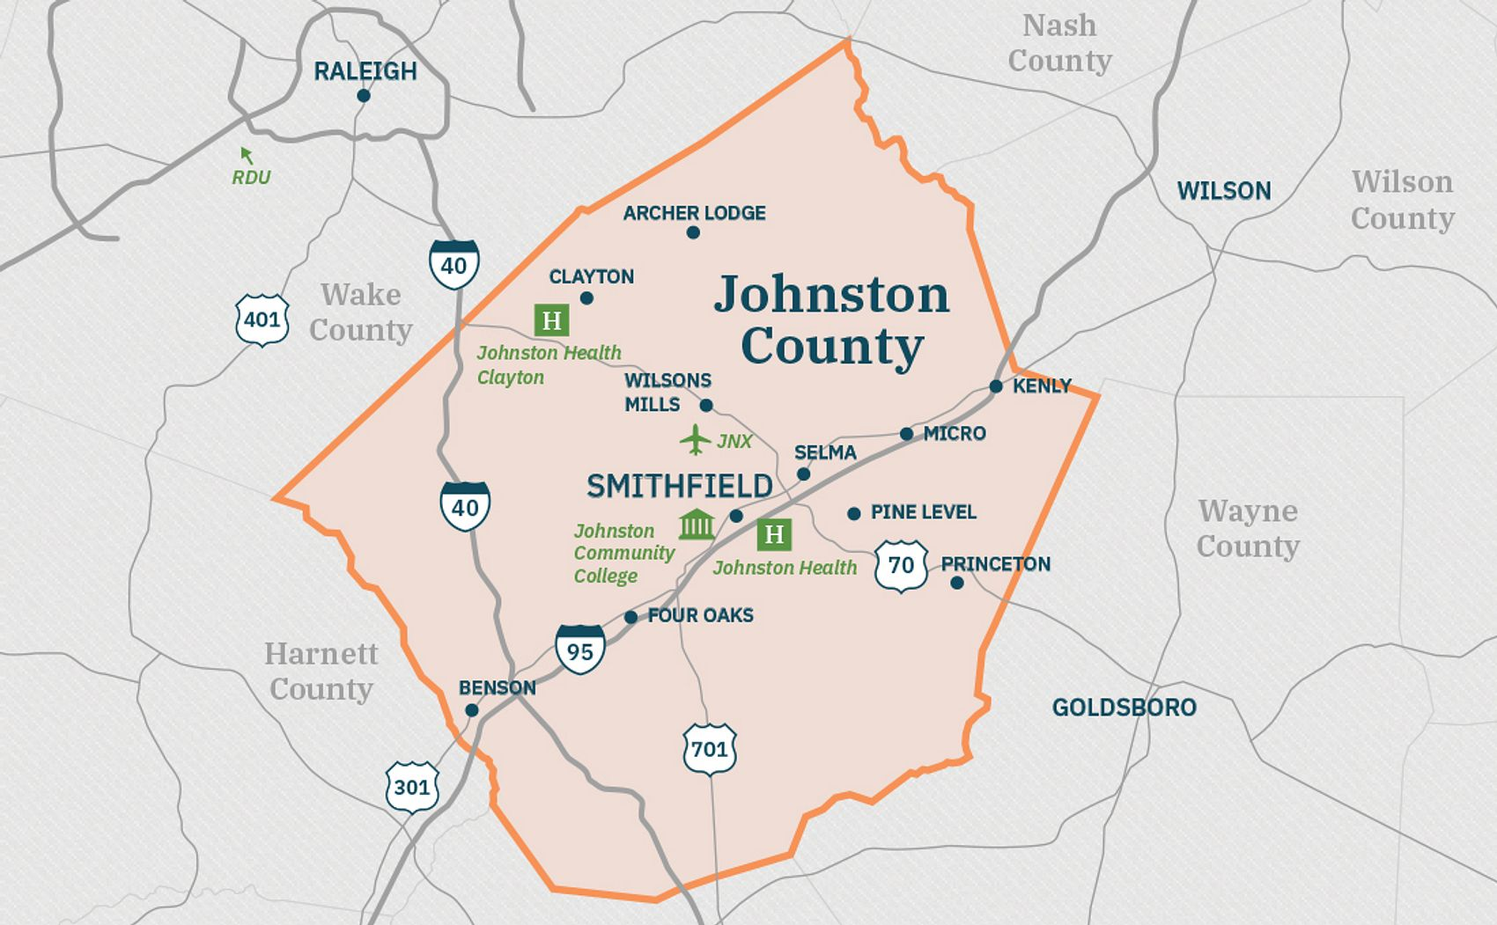
Study Site
Johnston County, North Carolina
Area: ~2,050 km²
Rapidly developing within Raleigh-Durham-Chapel Hill region
EPSG:32617
Johnston County, North Carolina
Notes:
Johnston County is located in eastern North Carolina between latitudes 35.3°N and 35.8°N, and longitudes 78.0°W and 78.6°W. Its proximity to a major metropolitan region makes it a prime location to observe and model urban expansion. By using a local Universal Transverse Mercator (UTM) projection (EPSG:32617), spatial accuracy is improved by minimizing distortions common in geographic coordinate systems. This area provides a realistic and relevant environment to test the framework’s ability to capture the nuances of rapidly changing urban landscapes.

Slide 6
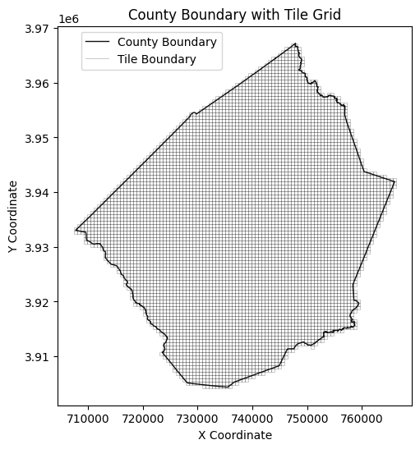
Data Sources and Extent
Sentinel-2 MSI imagery: 10m resolution, RGB & NIR bands (out of 13 available spectral bands)
NLCD imperviousness data: 30m resolution, updated every ~5 years
STAC APIs for data access (Microsoft Planetary Computer, AWS Earth Search)
Map displaying the boundary of Johnston County, North Carolina, overlaid with a 600x600-meter tile grid.
Notes:
The primary data sources include Sentinel-2 multispectral images accessed via SpatioTemporal Asset Catalog (STAC)-compliant APIs, which define a standardized structure for describing geospatial assets and thus ensure accessible, interoperable, and reproducible workflows. National Land Cover Database urban imperviousness data serve as the ground truth, albeit at a slightly coarser temporal resolution of 30 meters compared to the 10 meter resolution of the Sentinel-2 images. To manage computational loads and establish a clear framework for modeling, the county was divided into 600×600-meter tiles. This division creates uniform spatial units and simplifies the alignment of spectral and imperviousness data. As a result, the geospatial information is transformed into a structured, grid-based format that can be more readily incorporated into the machine learning workflows used in this project.

Slide 7
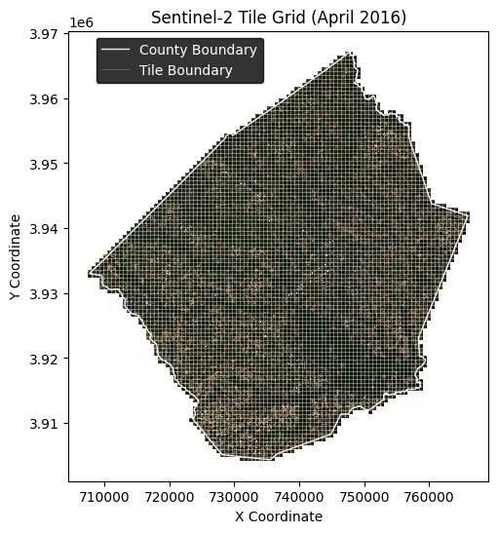
Data Processing Steps
Reproject boundaries to EPSG:32617
Generate 600×600m grid tiles
Resample urban imperviousness raster (to 200m), clip to 600x600m tiles
Align Sentinel-2 images with tiles
Sentinel-2 imagery of Johnston County in April 2016, overlaid with a 600x600-meter tile grid used and the county boundary
Notes:
When processing the data, first, county boundaries were reprojected to the EPSG:32617 Coordinate Reference System and arranged into a uniform grid of 600×600-meter tiles. Urban imperviousness data were resampled from 30 meters to 200 meters for computational efficiency when developing the predictive models, producing a 3×3 matrix per tile. In other words, the models developed predict 9 distinct values per 600x600 meter tile.
Sentinel-2 imagery was clipped and normalized to these tiles, focusing on key spectral bands (Blue, Green, Red, NIR) to preserve essential spectral information. Seasonal and annual variation were incorporated by selecting a total of 20 images from 2016 through 2024, with each image chosen to maintain minimal cloud cover.

Slide 8
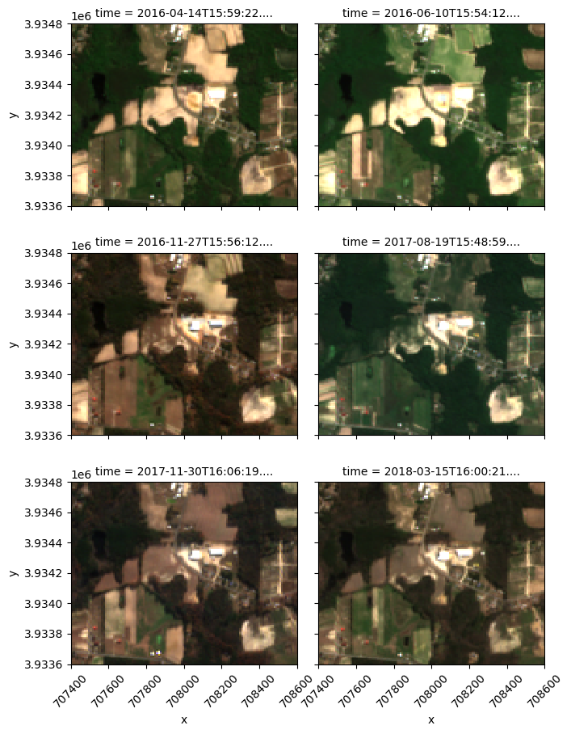
Temporal Data Selection
Sentinel-2: ~3 images per year (2016-2024)
Filtered by <1% cloud cover
Balanced temporal coverage
Notes:
Ensuring balanced temporal coverage required selecting approximately three cloud-free Sentinel-2 images per year. The chosen distribution captured seasonal variations and reduced temporal clustering. Although certain dates were unavailable due to weather or data gaps, careful filtering preserved a broad range of environmental conditions, enhancing the robustness of training and validation.

Slide 9

Earth Foundation Model Embeddings
Clay Model: pretrained on large Earth Observation datasets
Extract spatial embeddings
No manual feature engineering needed
Notes:
The Clay Foundation Model is an open-source Earth observation foundation model designed to capture a wide range of environmental conditions and patterns from satellite imagery. This model leverages a Vision Transformer architecture optimized for geospatial and temporal data, enabling it to understand not only static spectral information but also the context of location and seasonality. Unlike traditional approaches that demand extensive manual feature engineering, this model applies self-supervised learning methods—specifically, a Masked Autoencoder technique—to learn robust representations directly from the input data. As a result, the model produces embeddings that effectively condense complex environmental information into a manageable numeric form.
In this study, the Clay model was applied as a pretrained backbone to extract vectors of spatial embeddings from each tile’s Sentinel-2 imagery. These embeddings are already aligned with patterns commonly found in Earth observation data, reducing the dependence on manually curated features or external indices. Augmenting these core embeddings, additional temporal and spatial information was incorporated through sine/cosine transformations of dates and normalized latitude/longitude values. This integrated feature set provides a comprehensive input for modeling urban imperviousness, capturing not only spectral distinctions but also the temporal dynamics and geographic context essential for more accurate and timely predictions.

Slide 10

Earth Foundation Model Embedding Flow
Spectral-Spatial Data (pixels):
4 bands (Blue, Green, Red, NIR)
Each band normalized by known mean and standard deviation
Spatial resolution: 10 m
Tile size: 600 m × 600 m
Resulting pixel matrix: 60 × 60
(Overall spectral-spatial input: 4 × 60 × 60)
Temporal Embeddings:
Hour of day (h), normalized as:
sin(h*2π/24), cos(h*2π/24)
Week of year (w), normalized as:
sin(w*2π/52), cos(w*2π/52)
Spatial Embeddings:
Tile centroid latitude (lat) and longitude (lon) in radians
Normalized as:
sin(lat), cos(lat)
sin(lon), cos(lon)
Ground Sample Distance (GSD):
10 meters
* Sine/cosine transformations ensure cyclical patterns are properly represented
Datacube for each Date/Tile:
Spectral-Spatial Tensor: (4 × 60 × 60)
Temporal Vector: 4 scalars
Spatial Vector: 4 scalars
Waves Vector: 4 scalars
GSD: 1 scalar
For each Date/Tile:
Vector of embedded data: (768 x 1)
Notes:
The embedding process begins by integrating raw Sentinel-2 imagery and contextual information into a unified datacube. The spectral-spatial portion comprises four multispectral bands (Blue, Green, Red, NIR) sampled at 10-meter resolution, forming a 4 × 60 × 60 pixel matrix that represents a 600-meter by 600-meter tile. Each band is normalized by known mean and standard deviation values to ensure consistency across varying scenes. Temporal information, including the hour of day and week of year, undergoes sine and cosine transformations to capture cyclical patterns. The tile’s centroid latitude and longitude are similarly transformed to produce stable spatial references. Ground sample distance and per-band wavelength data are also included to reflect sensor and scene characteristics.
After assembling these components—spectral-spatial data, temporal vectors, spatial embeddings, wavelength metadata, and Ground Sample Distance—into the datacube, the Clay Foundation Model converts this rich, multidimensional input into a simple numeric vector embedding with a length of just 768 values. By compressing extensive raw data into a lower-dimensional feature vector, the model preserves essential information while enabling more efficient downstream analysis. This approach reduces the need for manual feature engineering and better positions predictive models, such as those for estimating urban imperviousness, to leverage the intricate interplay of spectral patterns, seasonal variations, and geographic context.

Slide 11
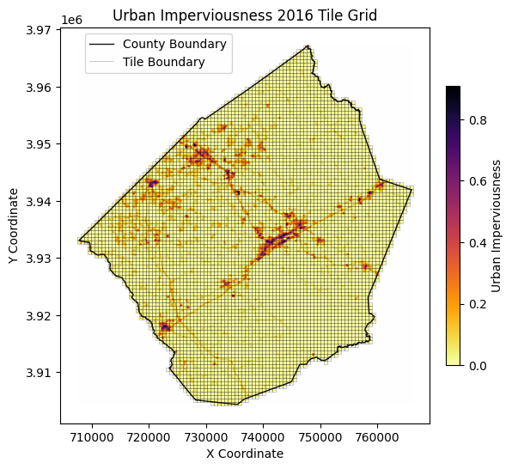
Target Variable: Urban Imperviousness
NLCD imperviousness as ground truth
Resampled to 200m (3×3 matrix per tile)
Normalized values [0,1]
Each 3×3 target matrix is paired with a 768-dimensional feature vector generated by the Clay Foundation Model, integrating Sentinel-2 imagery with temporal and spatial context at the corresponding tile.
Urban imperviousness across Johnston County in 2016 overlayed with 600x600m tile grid
Notes:
Once the embedding process is established, the next component is the target variable representing urban imperviousness. Using the National Land Cover Database (NLCD) imperviousness layer as ground truth, values are resampled from their native 30-meter resolution to 200-meter cells. This resampling translates each 600×600-meter tile into a 3×3 matrix of imperviousness percentages. Normalizing these percentages to a range from 0 to 1 range ensures numerical stability and compatibility with the modeling framework. As part of this project, obtaining and preparing the urban imperviousness data incorporated several concepts from the GIS582 course. Various resampling methods were explored, but the differences in data variation were minimal. Bilinear interpolation was ultimately selected as it provided a balance between computational efficiency and the preservation of continuous data characteristics when downsampling from 30 to 200 meters.
Each of these 3×3 target matrices is then paired with the 768-dimensional feature vector generated by the Clay Foundation Model. By linking the imperviousness targets directly to the embeddings—which already encapsulate spectral, temporal, and spatial information—subsequent models can learn relationships between observed urban development patterns and the underlying landscape signals. This alignment sets the stage for more accurate and timely estimates of urban growth.

Slide 12
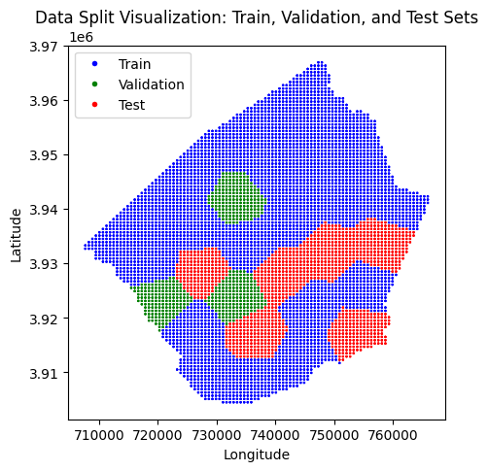
Data Splitting and Validation
Training, validation, and testing restricted to 2016
Sentinel-2 imagery provides multiple seasonal dates per tile
Urban imperviousness assumed constant in 2016 with minimal intra-annual variation
Spatial stratification ensures geographic consistency
Post-2016 data reserved for visualization and exploration
Stratified splits of 600x600m tiles for training (blue), validation (green), and testing (red) sets
Notes:
The training, validation, and testing datasets were restricted to 2016, consistent with the availability of National Land Cover Database imperviousness data. Sentinel-2 imagery, however, includes multiple acquisition dates within the year, allowing the model to incorporate seasonal spectral variability. While urban imperviousness is assumed to remain mostly constant throughout 2016, slight changes within the year may occur due some urban development as well as temporary or seasonal variations in land use or surface cover. This assumption introduces a small margin of error, but it was necessary to ensure a cohesive training framework.
Data splitting was conducted spatially using KMeans clustering on tile centroids. All dates for a given tile were retained within the same split, ensuring geographic consistency and avoiding spatial leakage. Testing and validation were also limited to 2016, ensuring that performance metrics reflect valid comparisons with the ground truth. Post-2016 data, while excluded from model training and testing, is used for visualization and exploratory analysis, demonstrating the framework’s applicability to future datasets.

Slide 13
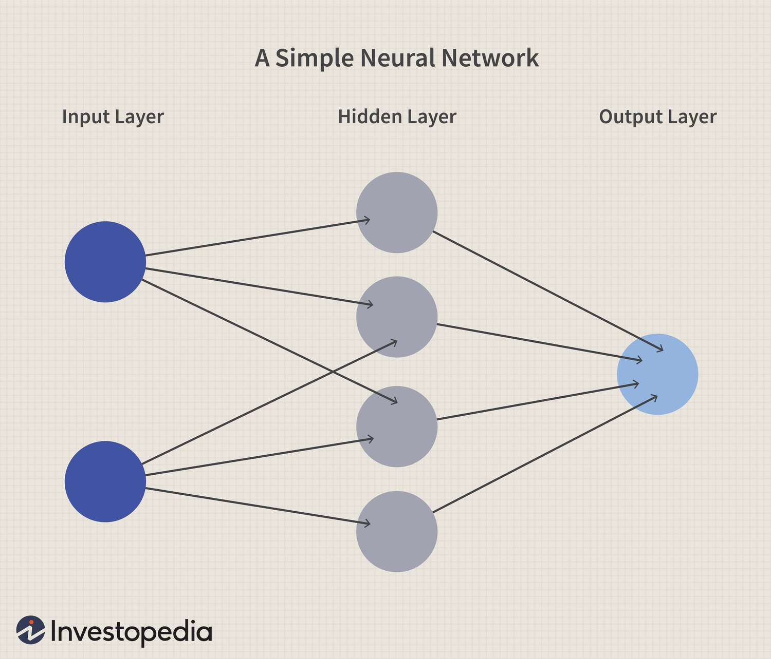
Neural Network Architectures
1. Simple Neural Network (SNN):
Input (768) → Hidden (128) → Output (9)
2. Deep Neural Network (DNN):
Input (768) → Hidden (128,128) → Output (9)
Notes:
Neural networks are computational models inspired by the structure and function of biological neurons. They consist of interconnected layers of nodes, or "neurons," that process input data to produce desired outputs. Each connection is associated with a weight, which is adjusted during training to minimize error. Deep learning extends this concept by introducing multiple hidden layers, enabling the network to learn hierarchical representations of data. This allows the model to capture complex, non-linear relationships that are difficult for traditional methods to detect.
In the context of this analysis, neural networks are particularly suited for modeling relationships between high-dimensional inputs, such as embeddings extracted from Sentinel-2 imagery, and corresponding target variables like urban imperviousness. By leveraging activation functions and optimization techniques, these models can iteratively refine their predictions, learning patterns inherent in the spectral and contextual features provided by the Clay Foundation Model embeddings.
Two feed-forward neural network architectures were tested to evaluate their ability to predict urban imperviousness. The SNN consisted of a single hidden layer with 128 neurons. This architecture allowed for an initial assessment of the information encoded in the embeddings. The DNN introduced an additional hidden layer with the same number of neurons, enabling the model to learn more complex mappings and hierarchical feature representations. Both architectures employed Rectified Linear Unit (ReLU) activation functions in the hidden layers to introduce non-linearity, while sigmoid activation functions in the output layer ensured predictions remained within the range of zero to one, the range of the urban imperviousness percentages.
Hyperparameter optimization was conducted for both models, including adjustments to learning rate, weight decay, and dropout rates. These techniques were employed to improve generalization and prevent overfitting, ensuring the models captured meaningful patterns rather than noise in the data. The evaluation of these architectures provides insights into the trade-offs between simplicity and complexity in predictive performance.

Slide 14
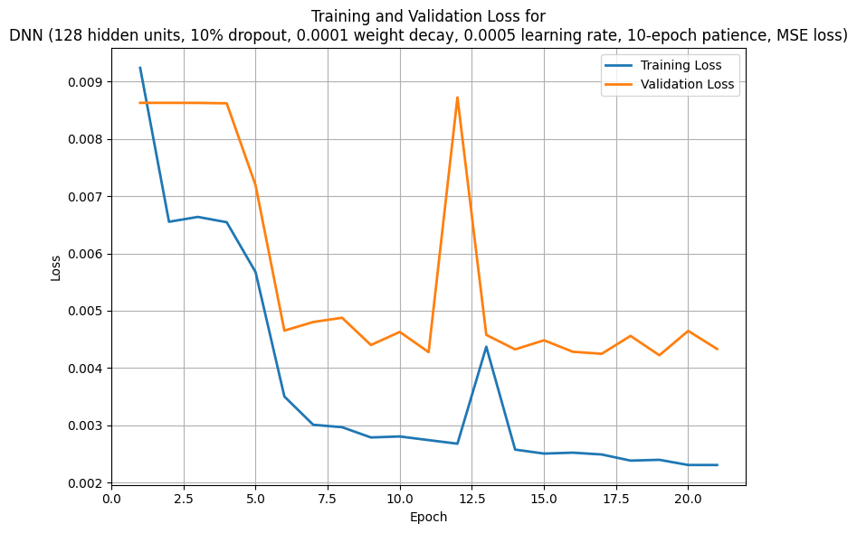
Model Training Details
Loss: Mean Squared Error (MSE)
Optimizations: Dropout, Weight Decay, Early Stopping
Baseline: Mean imperviousness from training data
Training and validation loss curves for the DNN model (128 hidden units, 10% dropout, 0.0001 weight decay, 0.0005 learning rate, 10-epoch patience, MSE loss)
Notes:
Model training focused on minimizing the mean squared error (MSE) between predicted and observed imperviousness values. This loss function ensures that large prediction errors are penalized more heavily, guiding the optimization process. Regularization techniques, including dropout and weight decay, were implemented to prevent overfitting, ensuring the models generalized well to unseen data. Early stopping was used to halt training once the validation loss ceased improving, further enhancing generalization by avoiding over-training. A simple baseline model was established by predicting the mean imperviousness value from the training data, providing a benchmark for evaluating the neural network architectures. Performance improvements over this baseline confirm the models’ ability to capture patterns beyond average imperviousness values, leveraging the spectral and contextual features encoded in the Clay-derived embeddings.

Slide 15
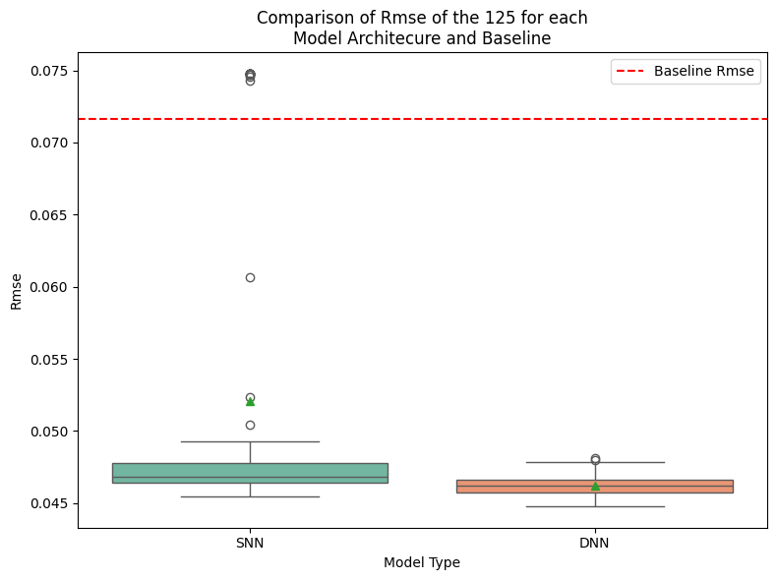
Preliminary Results
Most DNN architectures model outperform the baseline and SNN models
Predicted imperviousness aligns with known urban areas
Some seasonal and data gaps remain
Comparison of RMSE for the top 125 SNN and DNN models, with the baseline RMSE as a reference (red dashed line).
Notes:
Initial results demonstrate that the deep neural network (DNN) architectures tested tended to surpasses both the simple neural network (SNN) architectures and the baseline model in performance, as evidenced by lower model metrics. These results indicate that the DNN effectively leverages the Clay Foundation Model embeddings to translate spectral and contextual features into accurate urban imperviousness estimates. Predictions align closely with known urbanized areas in Johnston County, capturing spatial patterns at a 600×600-meter scale.
Despite these promising results, some uncertainties remain due to seasonal variability in Sentinel-2 imagery and occasional data gaps. Seasonal changes in vegetation or surface reflectance may introduce slight errors, particularly in areas where spectral features shift across seasons. Addressing these challenges through further temporal validation and enhanced preprocessing might help with improving the robustness and reliability of the model.

Slide 16
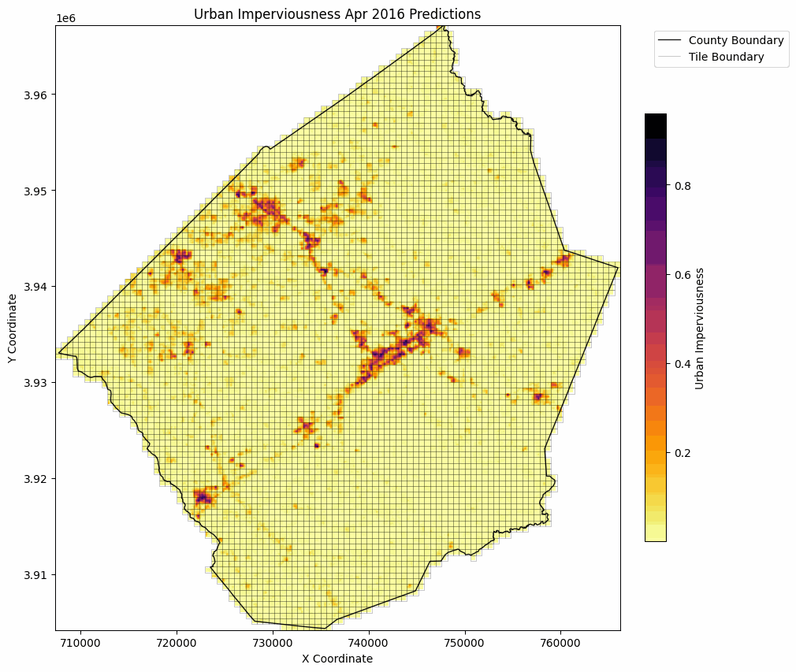
Predicting Post-2016 Data
Evaluate generalization on unseen data
Predictions align with observed urban growth trends
Detect changes in imperviousness from 2016 to 2024
Notes:
The predictive framework was applied to post-2016 data to evaluate its ability to generalize to unseen temporal intervals. Initial predictions align with observed trends in urban growth, capturing expansions in impervious surfaces consistent with known development patterns in Johnston County. This capability demonstrates the framework’s potential for detecting dynamic changes in urban imperviousness over time. Future steps include validating these predictions against additional ground truth data to further assess accuracy.

Slide 17
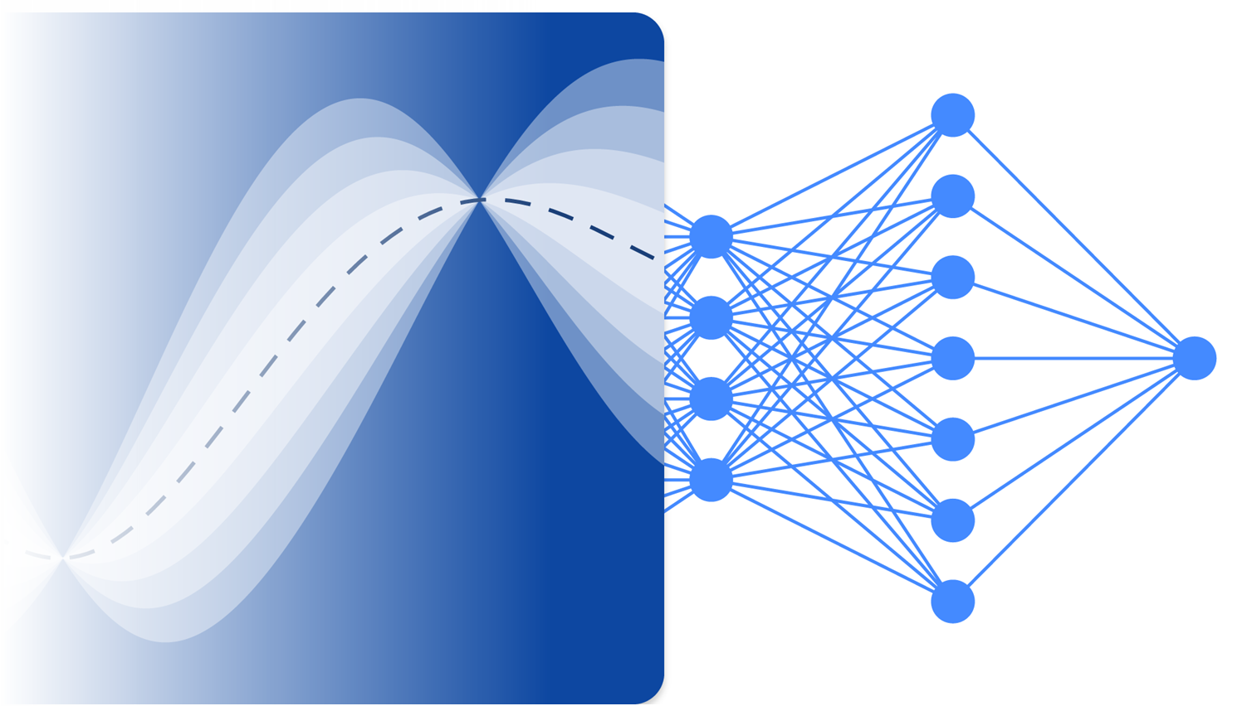
Next Steps in this Project
Residual analysis to identify patterns in prediction errors
Quantify uncertainty in predictions
Notes:
Although the model development and training phases of this project are complete, the current focus is on analyzing the results to better understand the model’s performance and limitations. This includes conducting a detailed residual analysis to uncover patterns in the prediction errors, which may reveal specific areas where the model under - or overestimates urban imperviousness. Additionally, quantifying uncertainty in the predictions at the tile level will provide insights into the confidence of the model across different spatial and temporal regions.

Slide 18

Future Work
Fine-tune embeddings for regional specificity
Explore convolutional architectures for spatial feature learning
Incorporate additional spectral indices or auxiliary data
Train on multiple years for a more robust model
Extend analysis to other geographic areas
Notes:
Future work might focus on fine-tuning the Clay Foundation Model embeddings to better capture region-specific patterns of urban growth. Investigating convolutional architectures may provide enhanced spatial feature learning, improving the model’s ability to represent localized urbanization trends. Incorporating auxiliary data, such as vegetation indices, nighttime lights, or socioeconomic variables could further improve model performance. Extending this methodology to other regions experiencing rapid urbanization would validate the framework’s scalability and robustness.

Slide 19
Summary and Conclusions
Foundation models provide scalable solutions for urban monitoring
Sentinel-2 imagery enables high-temporal-resolution analysis
The framework demonstrates feasibility for frequent imperviousness mapping
Future enhancements will focus on scalability and accuracy
Notes:
In summary, this study highlights the potential of integrating foundation models with Sentinel-2 imagery for urban growth monitoring, as well as similar remote-sensing applications. The proposed framework leverages the high temporal resolution of Sentinel-2 and the advanced feature representation capabilities of the Clay Foundation Model to generate frequent and reliable imperviousness estimates. These findings demonstrate a scalable and data-efficient approach to urban monitoring, addressing the limitations of traditional datasets. Future efforts will aim to enhance model accuracy, extend analysis to additional regions, and validate the framework’s applicability in broader contexts.

